Slide 1
Survey Section
Top 10 Plan Review Comments

Slide 2
MassDOT Highway Division Survey Section
Mehdi Sadjady
Survey Base Plan Engineer
(978) 831-8311
Mehdi.Sadjady@dot.state.ma.us
2
| Leading the Nation in Transportation Excellence | www.mass.gov/massdot

Slide 3
MassDOT Highway Division Survey Section
Overview of MassDOT Base Plan Review Process
https://www.mass.gov/orgs/highway-division
Manuals:
Survey Manual (Metric Edition) 1996
Project Development & Design Guide (Chapter 18)
LRFD Bridge Manual 2013 and 2020 Rev.
CAD Standards Manual
Field Survey Guidelines & Base Plan Requirements
3
| Leading the Nation in Transportation Excellence | www.mass.gov/massdot

Slide 4
1. Survey Scope & Limits
General Limits
Bridge Projects and Hydraulics Limits
ADA Ramp Projects Limits
Buildings
Wetlands
Utilities
4
| Leading the Nation in Transportation Excellence | www.mass.gov/massdot

Slide 5
2. Template and Drawing Setting
Folder Structures
Template
Survey Database
Units and Zone
Point Groups
Surface
Layers
Label Styles
Plotting Style (MADOT-S)
5
| Leading the Nation in Transportation Excellence | www.mass.gov/massdot

Slide 6
3. Title Sheet
Sheet Management Tool
Plan Index
Orientation of Plan
General Notes
Plan References
Surveyor Signature and Stamp (250 CMR)
6
| Leading the Nation in Transportation Excellence | www.mass.gov/massdot

Slide 7
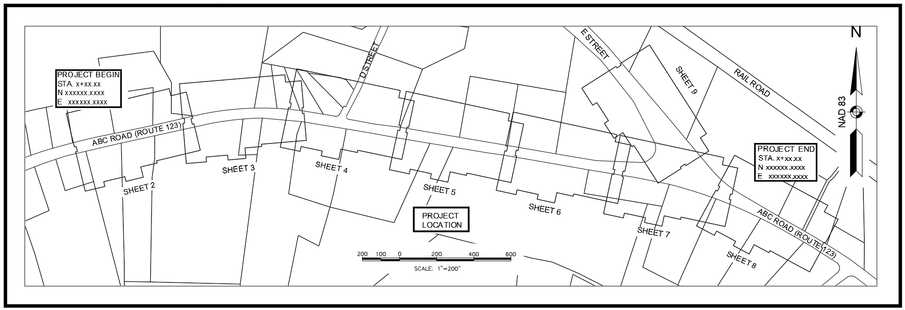
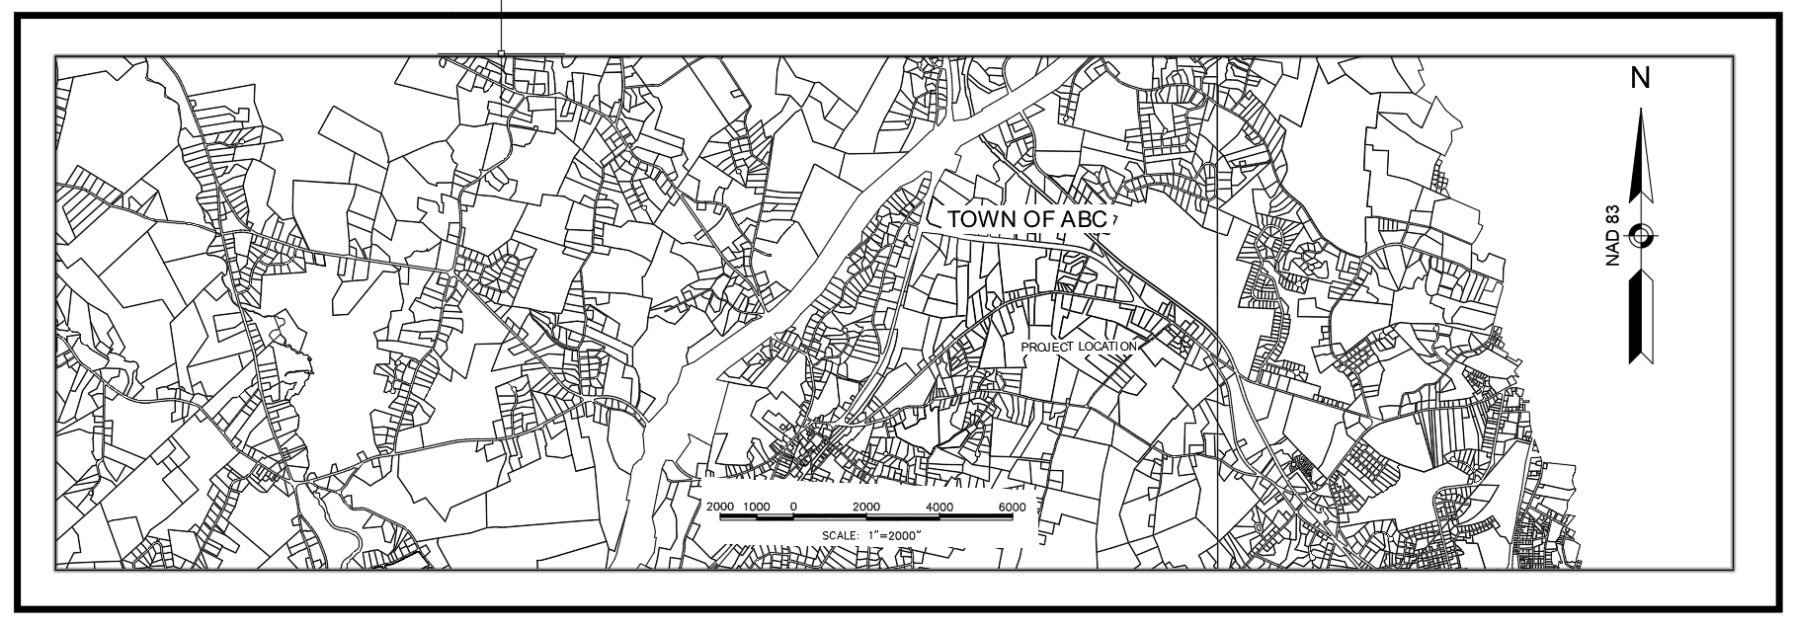
3. Title Sheet
Sample of Acceptable Key Map:
Sample of Unacceptable Key Map:
7
| Leading the Nation in Transportation Excellence | www.mass.gov/massdot

Slide 8
4. Surface
Break Lines
Center line or Possible Crown
Edge of Pavement, Concrete, Gravel & …
Paved Shoulder
LiDAR Surface
Bridge Surface
Bridge Deck
Conventional survey and LiDAR Surface
Export to DEM
8
| Leading the Nation in Transportation Excellence | www.mass.gov/massdot

Slide 9
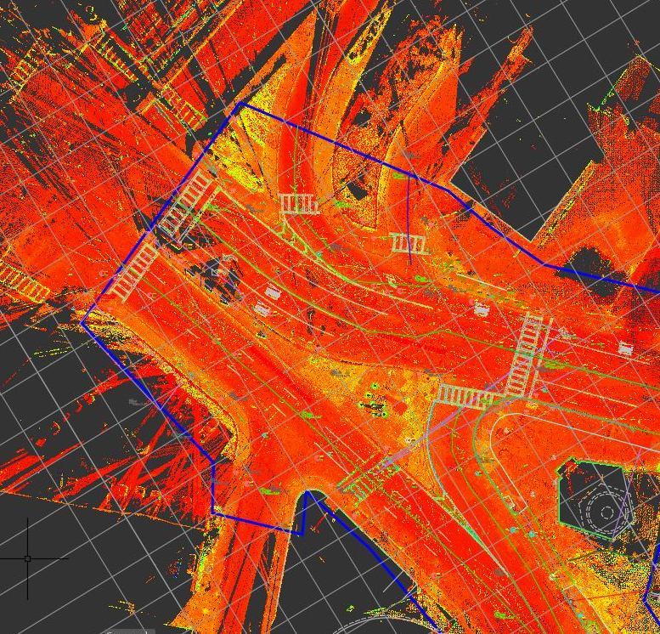
4. Surface
9
| Leading the Nation in Transportation Excellence | www.mass.gov/massdot

Slide 10
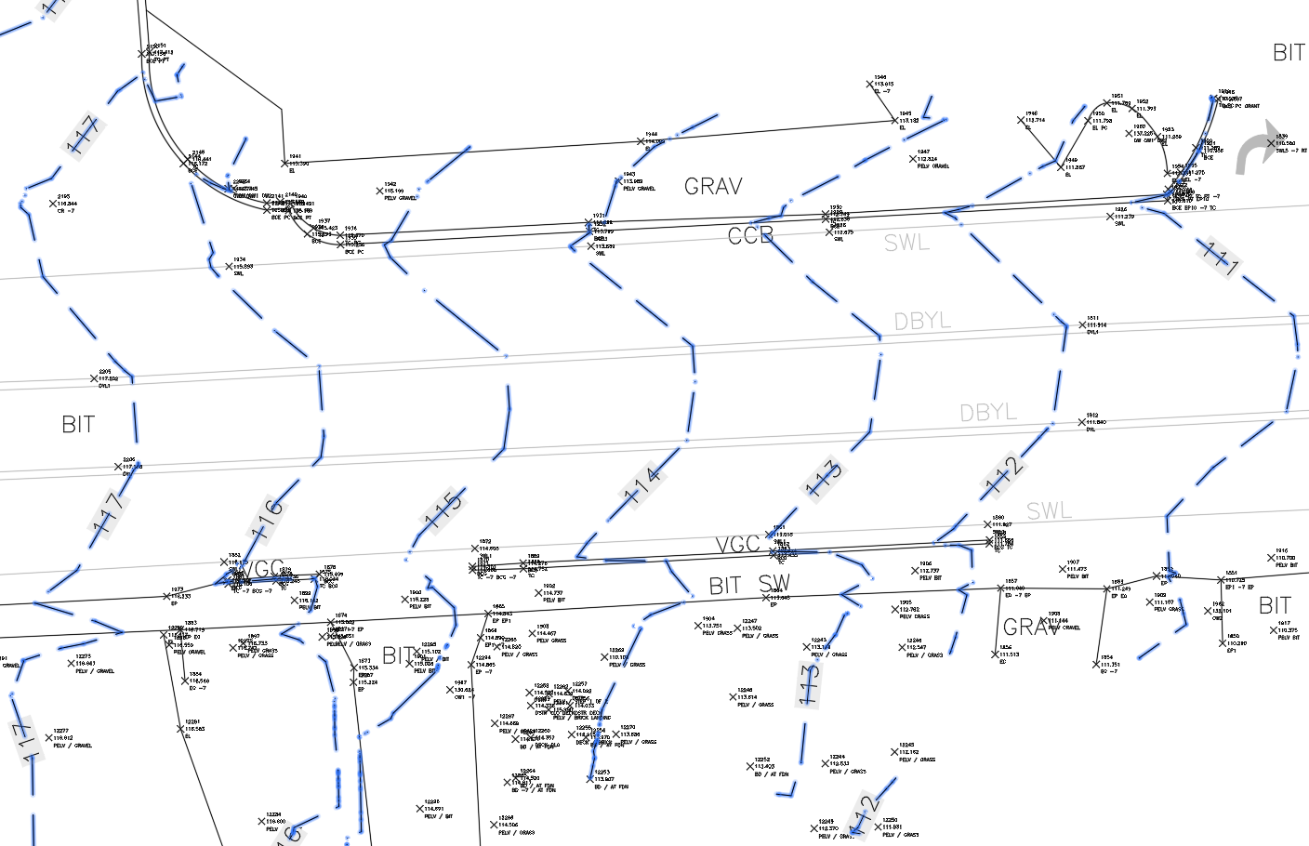
4. Surface
10
| Leading the Nation in Transportation Excellence | www.mass.gov/massdot

Slide 11
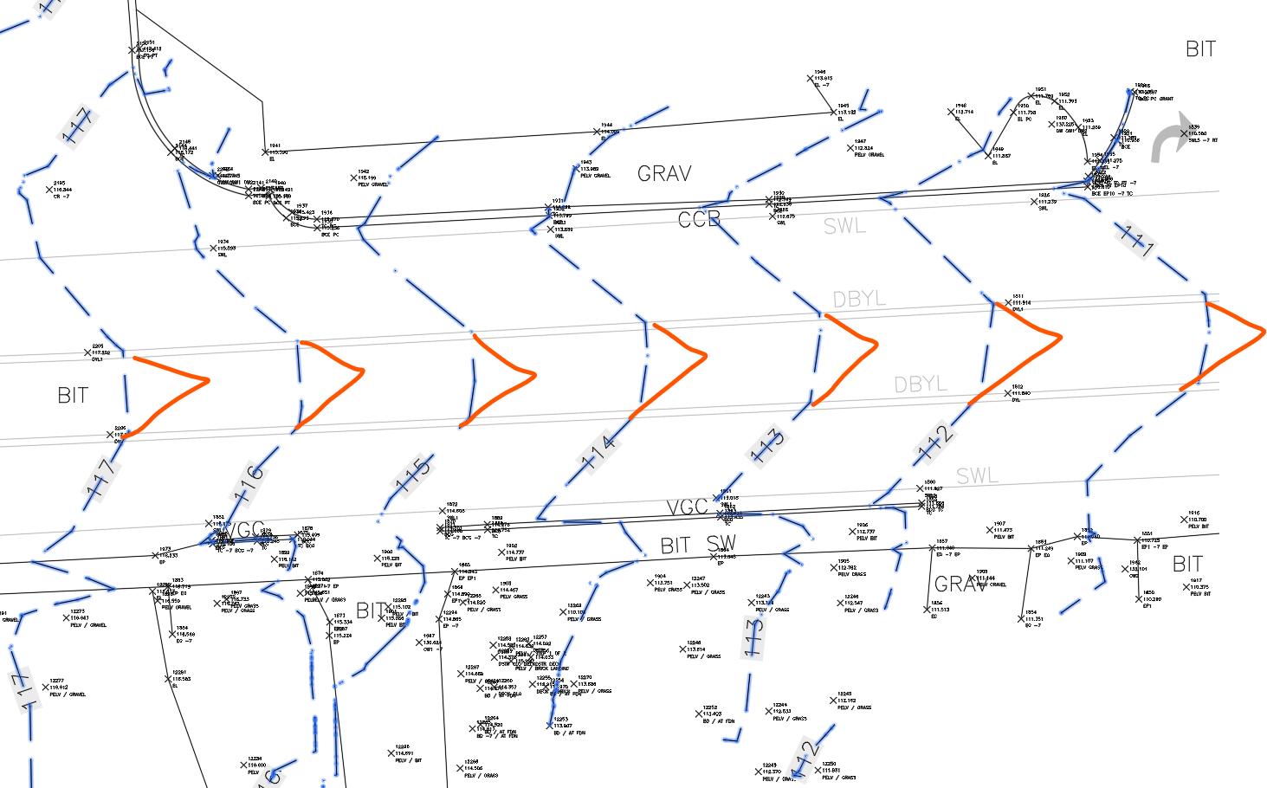
4. Surface
11
| Leading the Nation in Transportation Excellence | www.mass.gov/massdot

Slide 12
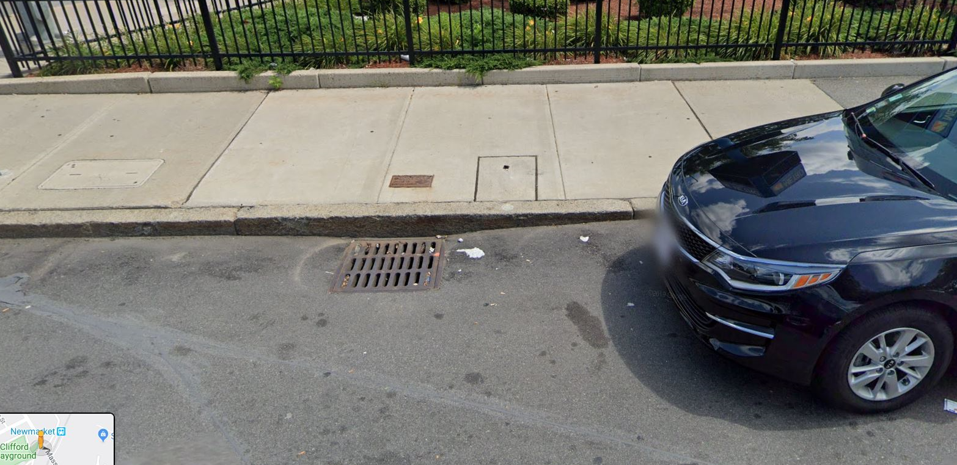
4. Surface
12
| Leading the Nation in Transportation Excellence | www.mass.gov/massdot

Slide 13
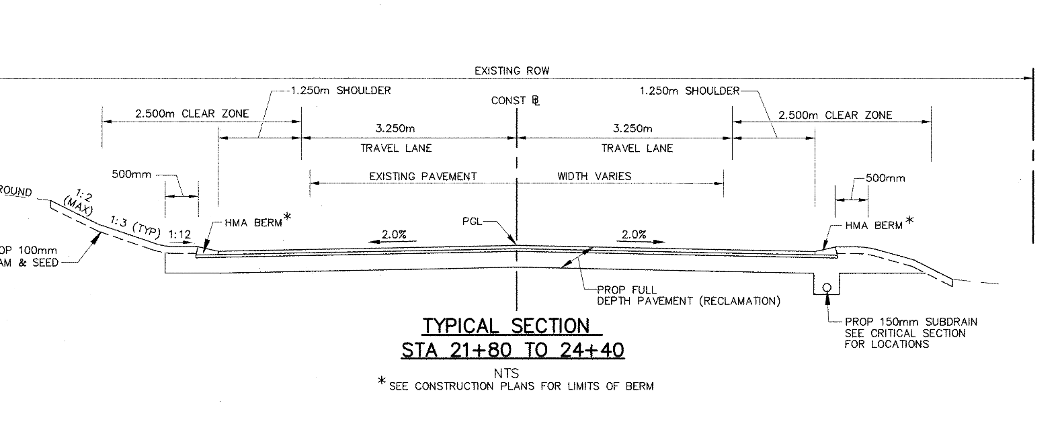
4. Surface
13
| Leading the Nation in Transportation Excellence | www.mass.gov/massdot

Slide 14
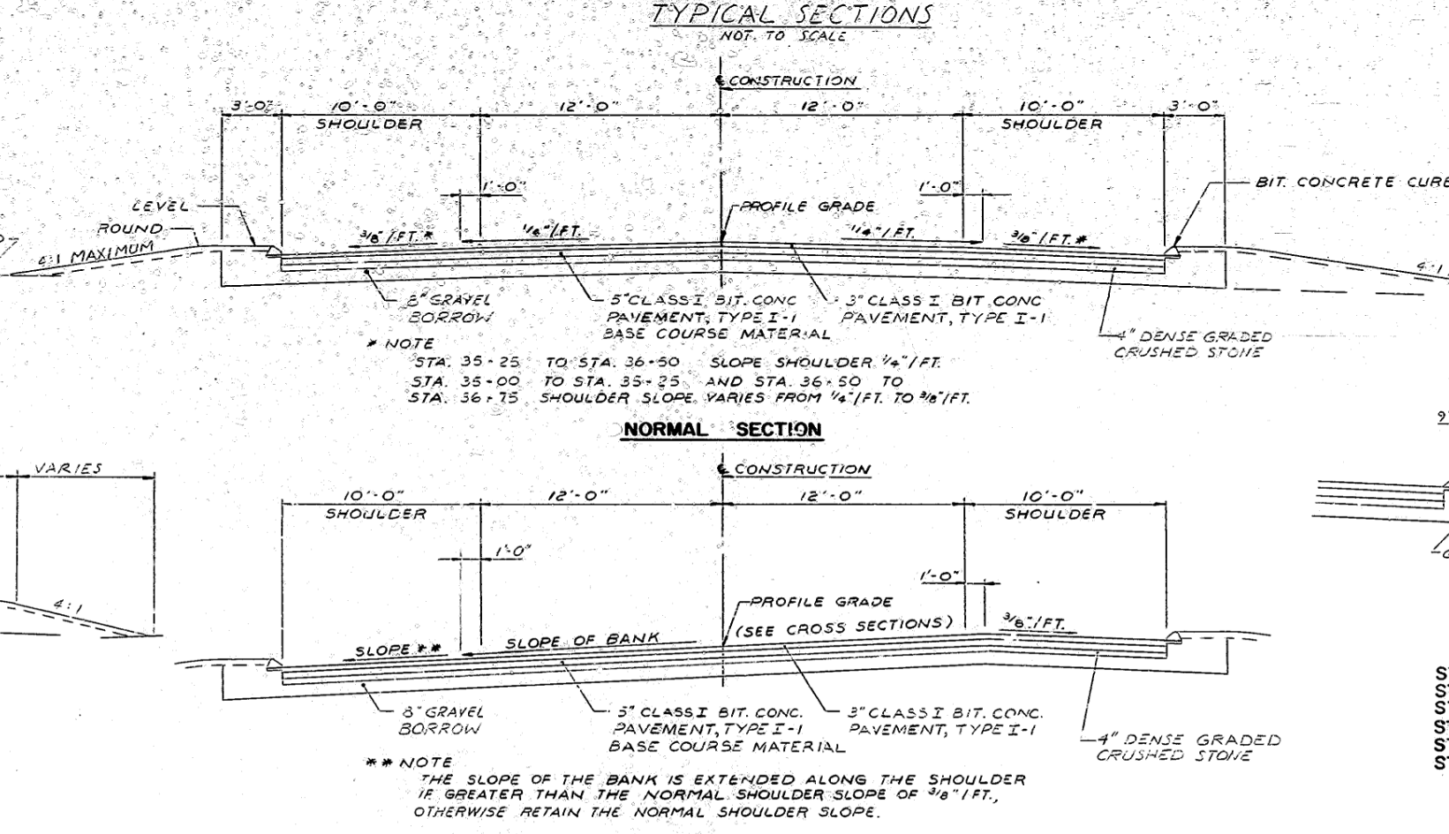
4. Surface
14
| Leading the Nation in Transportation Excellence | www.mass.gov/massdot

Slide 15
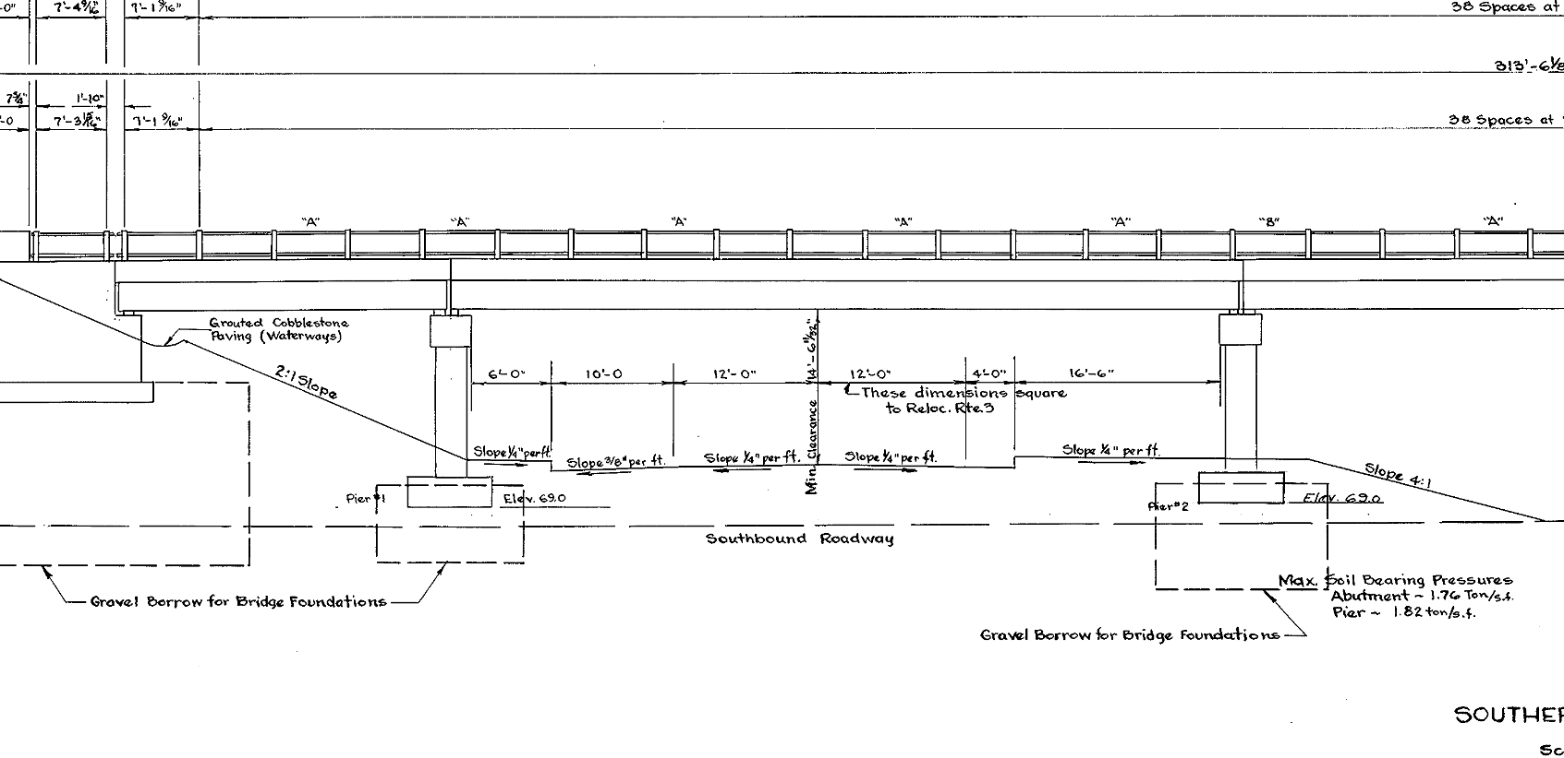
4. Surface
15
| Leading the Nation in Transportation Excellence | www.mass.gov/massdot

Slide 16
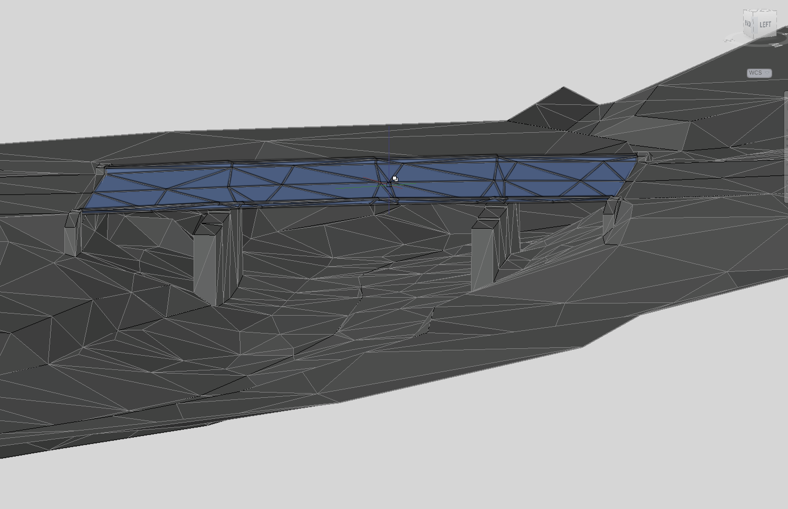
4. Surface
16
| Leading the Nation in Transportation Excellence | www.mass.gov/massdot

Slide 17
5. Utilities
Field Survey
Location
Inspection (No Confined Space Entry)
Record Plans
City/Town Design and/or As-Built
MassDOT Design Plans
Layering
EXISTING: (Layer convention EX-UT-)
Utility objects that have been observed and field located
RECORD: (Layer convention RD-UT-)
Utility objects that have not been observed and/or physically located
PROPOSED: (Layer convention: PR-UT-)
17
| Leading the Nation in Transportation Excellence | www.mass.gov/massdot

Slide 18
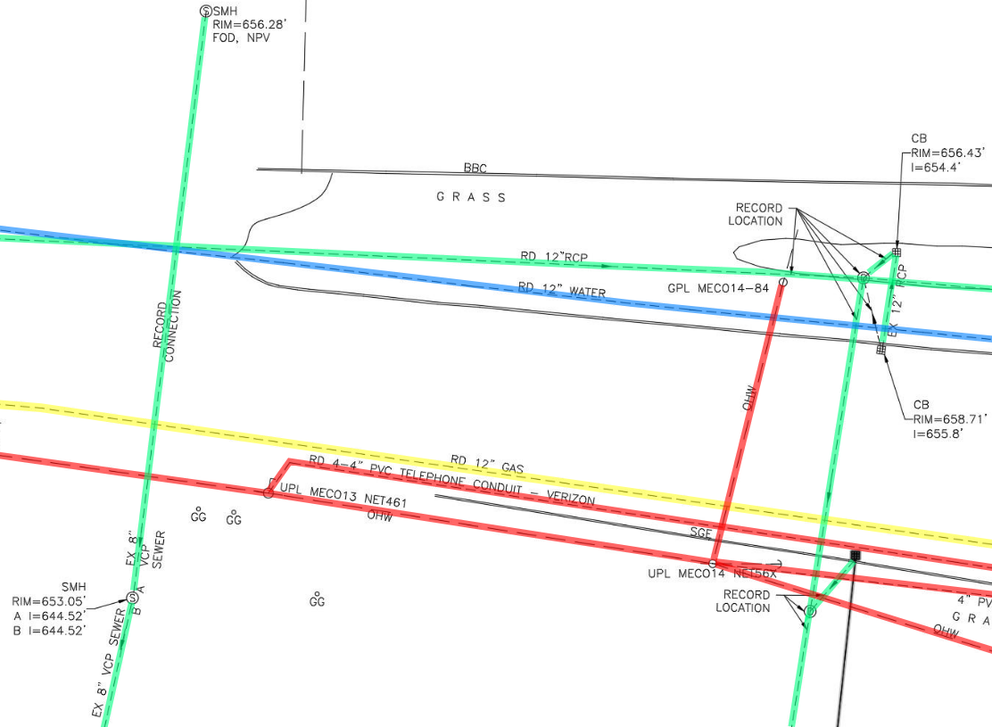
5. Utilities
18
| Leading the Nation in Transportation Excellence | www.mass.gov/massdot

Slide 19
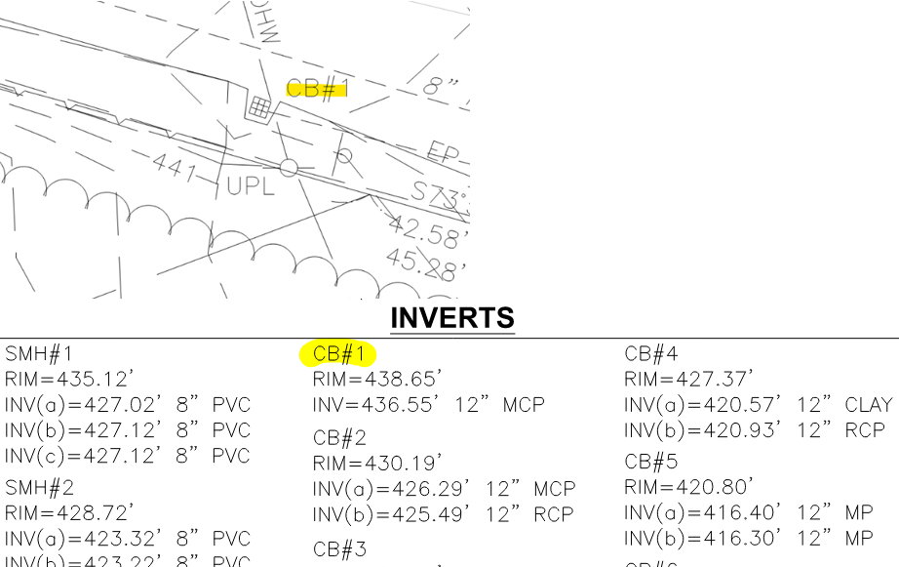
5. Utilities
Inverts Identification
19
| Leading the Nation in Transportation Excellence | www.mass.gov/massdot

Slide 20
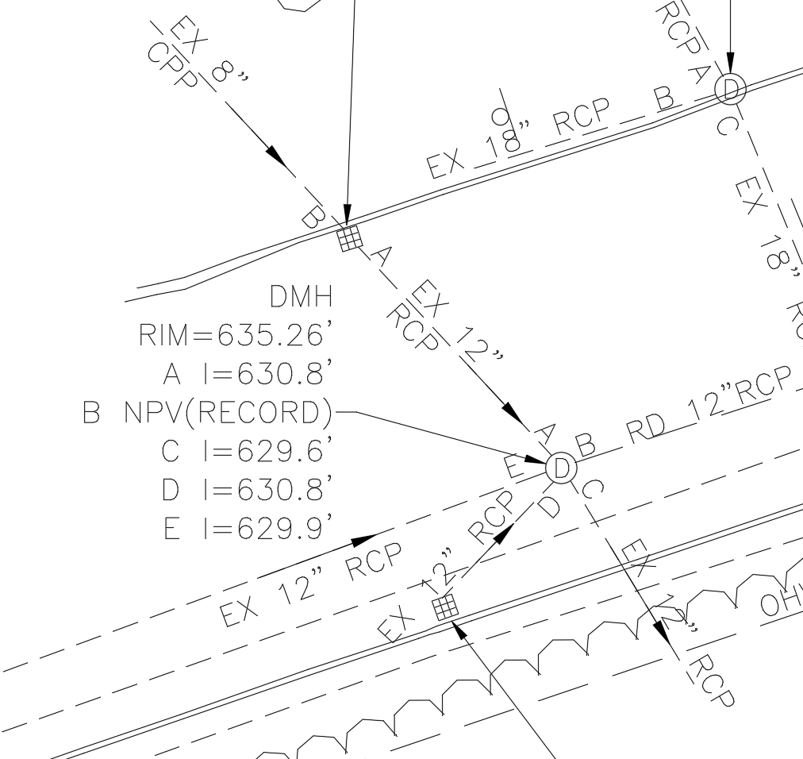
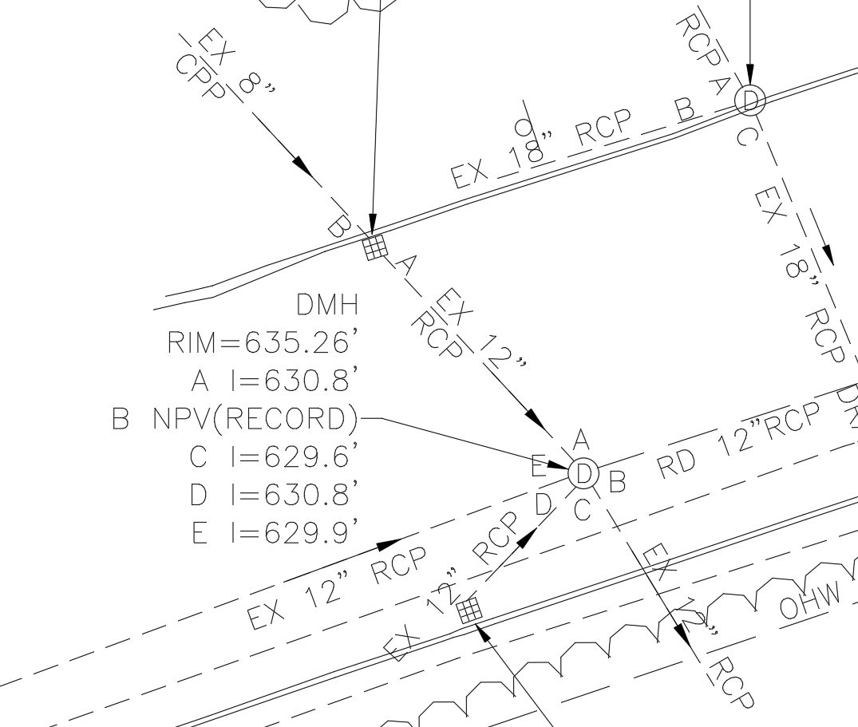
5. Utilities
Inverts Identification
20
| Leading the Nation in Transportation Excellence | www.mass.gov/massdot

Slide 21
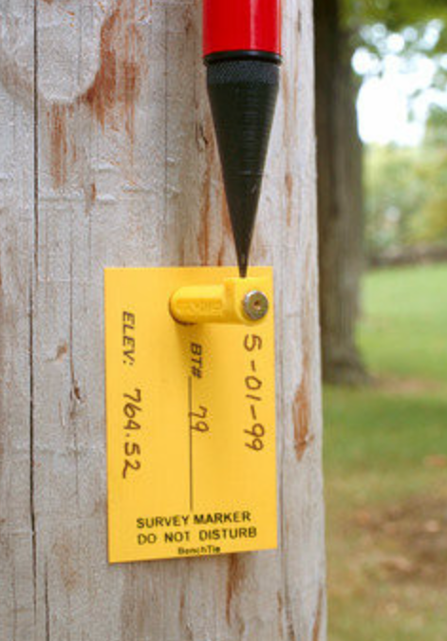
6. Bench Marks
Survey Manual 1966
Every 300m (984 feet)
Bridge Projects
Solid Benchmarks
21
| Leading the Nation in Transportation Excellence | www.mass.gov/massdot

Slide 22
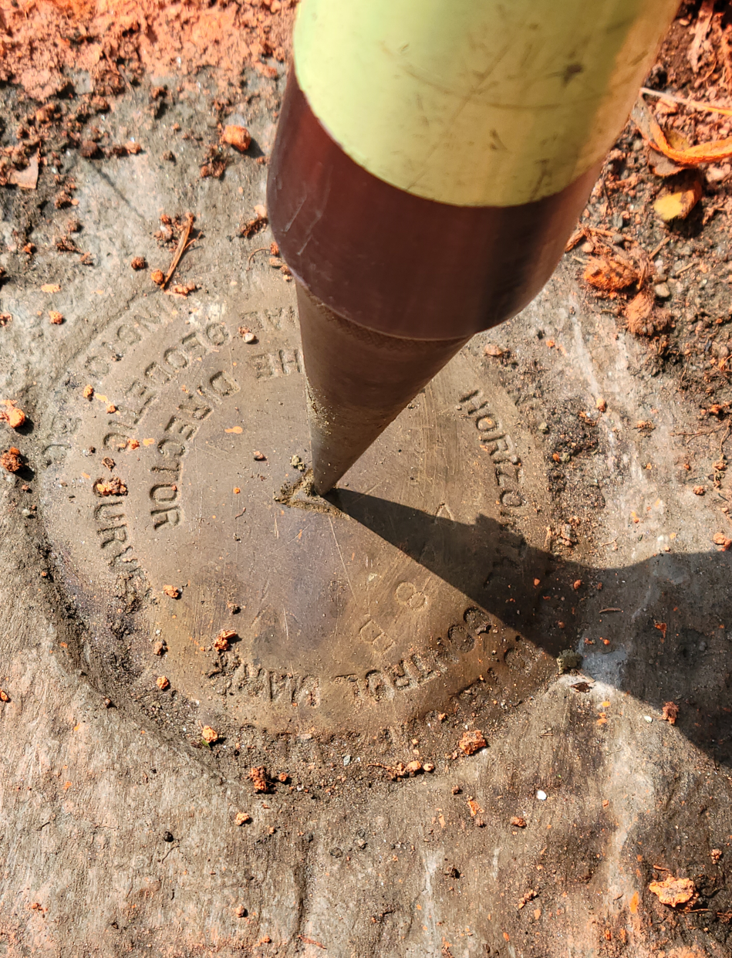
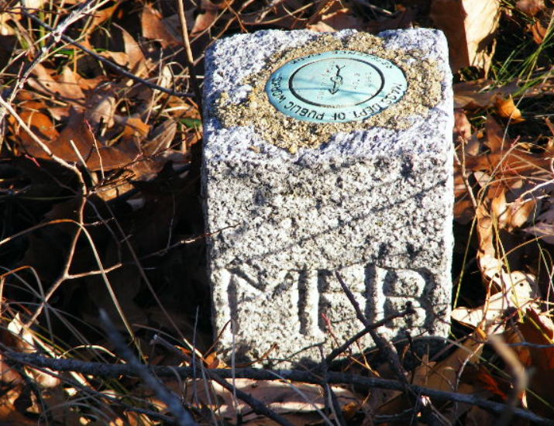
7. Monuments & Controls
Symbol
Label
Held for Position/Held for Bearing
Monument Condition
Traverse Running lines and labels
22
| Leading the Nation in Transportation Excellence | www.mass.gov/massdot

Slide 23
8. Abutting Properties
Property lines established by compiling information from best available sources (Frontage)
MassGIS IS NOT OKAY
Deed of Property
Record Plans of Property
Subdivision Plans
Land Court Plans
Frontage Issue after taking.
Easements
23
| Leading the Nation in Transportation Excellence | www.mass.gov/massdot

Slide 24
8. Abutting Properties
Property Information
City/Town Assessor Data Base
Registry of Deeds
Required information
Current Owner
Deed Book & Page and Plan
Address
Property ID(Map/Lot)
ROW Manual Format
24
| Leading the Nation in Transportation Excellence | www.mass.gov/massdot

Slide 25
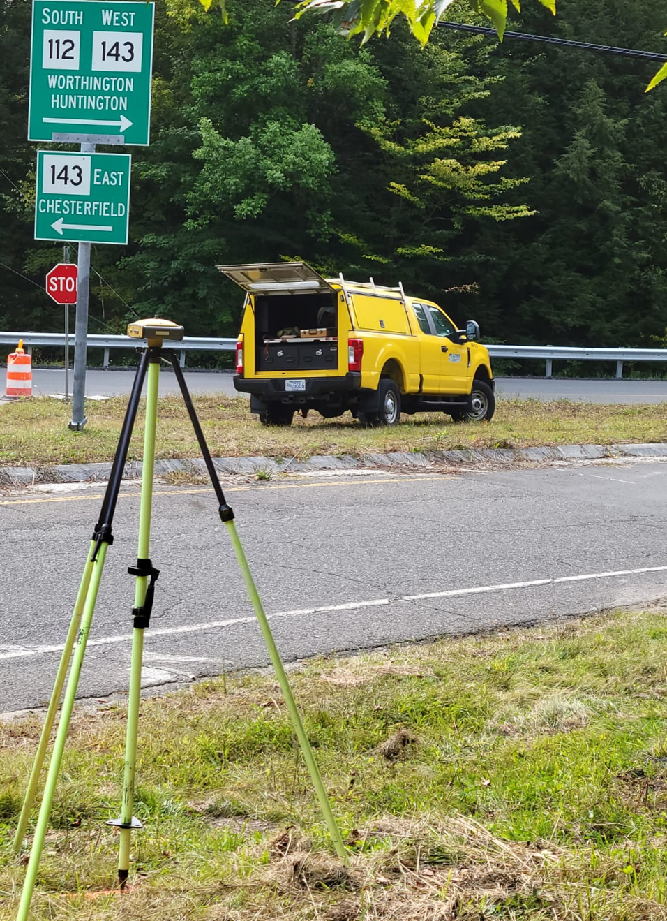
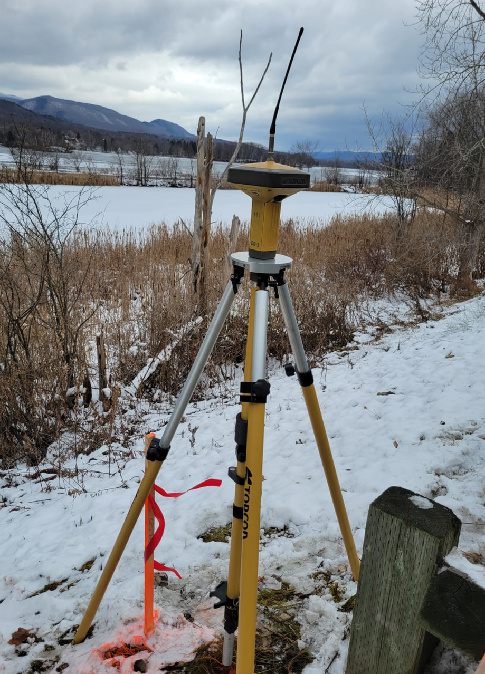
9. MassDOT Provided Control Points
Hold Coordinates
Elevation/Levels
25
| Leading the Nation in Transportation Excellence | www.mass.gov/massdot

Slide 26
9. MassDOT Provided Control Points
26
| Leading the Nation in Transportation Excellence | www.mass.gov/massdot

Slide 27
9. MassDOT Provided Control Points
27
| Leading the Nation in Transportation Excellence | www.mass.gov/massdot

Slide 28
10. Right-of-Way
To Be Determined
State, County, Town, Private
Record Baseline
State Highway Layout Issues
No Monuments Found in Field
Bounds Don’t “Fit” the Layout
Bounds “Fit” Layouts Individually
Layouts Don’t Connect Mathematically
Errors Found in Layout Math
Roadways Status & Width
Side Lines and Base lines Labels, Annotations
28
| Leading the Nation in Transportation Excellence | www.mass.gov/massdot

Slide 29
Aerial Site View
Questions?
29
| Leading the Nation in Transportation Excellence | www.mass.gov/massdot

